Slide 1
15
International Corporate Governance and Control
Chapter Objectives
Describe the common forms of corporate governance by MNCs.
Explain how MNC’s use corporate control as a form of governance.
Identify the factors that are considered when valuing a foreign target.
Describe the process of valuing a foreign target.
Explain why valuations of a target firm vary among MNCs that consider corporate control strategies.
1

Slide 2
15
International Corporate Governance and Control
Chapter Objectives (Contd.)
Identify other types of international corporate control decisions.
Explain how some corporate control decisions can be evaluated in a real time options framework.
2

Slide 3
International Corporate Governance (1 of 3)
Governance by Board Members — The Board of Directors is responsible for appointing high-level managers of the firm including the CEO.
The board is supposed to make sure that key management decisions are in the best interest of shareholders.
However, boards are not always effective at governance.
Some allow the firm’s CEO to serve as the chair of the board.
Boards typically contain insiders (managers working for the firm) who might prefer policies that favor management.
Board members who are employees of a foreign subsidiary may maximize the benefits to the subsidiary.

Slide 4
International Corporate Governance (2 of 3)
Governance by Institutional Investors
Institutional investors
  pension funds
  mutual funds
  hedge funds
  and insurance companies
The ability or willingness to enforce governance commonly varies among types of institutional investors.

Slide 5
International Corporate Governance (3 of 3)
Governance by Shareholder Activists
Some institutional investors or individual shareholders of publicly traded MNCs are called blockholders because they hold a large proportion (Block – at least 5%) of the firm’s stock.
Blockholders commonly become shareholder activists, that is, they take actions to influence management.

Slide 6
International Corporate Control (1 of 7)
Market for Corporate Control
  If managers make decisions that destroy value, the MNC could be subject to takeover and managers could lose their jobs.
  Market for corporate control is a means for MNCs to achieve expansion goals
Motives for International Acquisitions
  Comparative advantage
  Better form of direct foreign investment
Trends in International Acquisitions
  Traditionally, MNCs in various countries tend to focus on specific geographic regions and use stocks or cash to make their purchases depending on shareholder power.
  International acquisitions have generally increased over time. However, the pace slowed during the credit crisis in 2008.

Slide 7
International Corporate Control (2 of 7)
Barriers to International Corporate Control
Anti-takeover amendments implemented by target: an anti-takeover amendment that requires a large proportion of shareholders to approve the takeover.
Poison pills implemented by target: Grants special rights to managers or shareholders under specified conditions.
Host government barriers: Governments of some countries restrict foreign firms from taking control of local firms, or they may allow foreign ownership of local firms only if specific guidelines are satisfied.

Slide 8
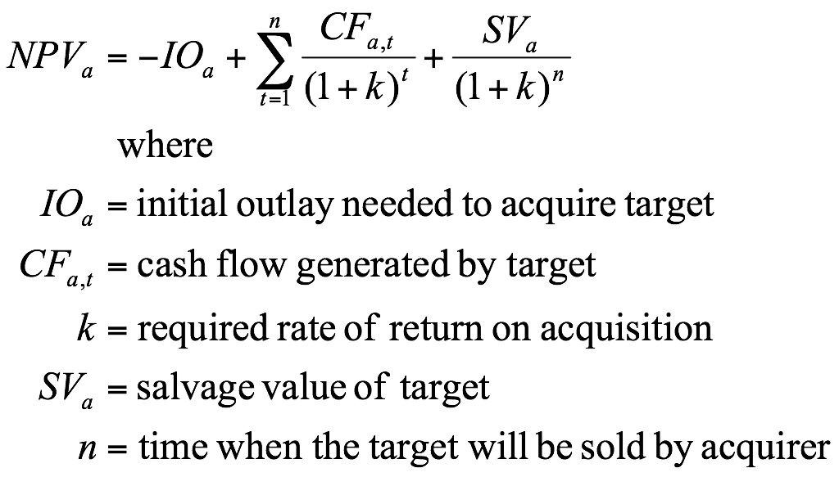
International Corporate Control (3 of 7)
Model for Valuing a Foreign Target
When an MNC engages in restructuring, it affects the structure of its assets, which will ultimately affect the present value of its cash flows.

Slide 9

International Corporate Control (4 of 7)
Model for Valuing a Foreign Target (cont.)
Estimating the initial outlay – the price to be paid for the target
  Firms commonly pay premiums (30%) above the prevailing stock price of a foreign target to gain ownership.
  The initial dollar outlay (IO_{U.S.}) is determined by the acquisition price in foreign currency (IO_{f}) and the spot price of the foreign currency (S):

Slide 10

International Corporate Control (5 of 7)
Model for Valuing a Foreign Target (cont.)
Estimating the Cash Flows
  The estimated foreign currency cash flows that are to be converted must account for any taxes or blocked-funds restrictions imposed by the host government.
  The dollar amount of cash flows to the U.S. firm is determined by the foreign currency cash flows (CF_{f,t}) per period and the spot rate at that time (S_{t})
  Also, consider Salvage values; Sva = (SVf)Sn
    The salvage value in foreign currency units times the spot rate at the time (when it will be converted to US$)

Slide 11
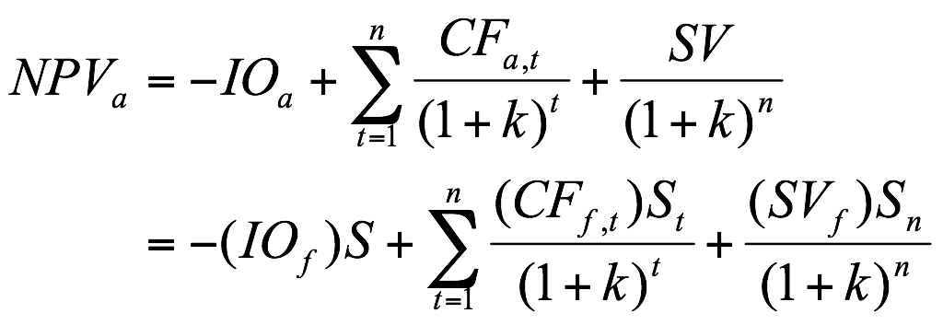
International Corporate Control (6 of 7)
Model for Valuing a Foreign Target (cont.)
Estimating the NPV
  The net present value of a foreign target can be derived by substituting the equalities just described in the capital budgeting equation
.

Slide 12
International Corporate Control (7 of 7)
Impact of the SOX Act on the valuation of the target –
Improved the process for reporting profits used by U.S. firms (including U.S.-based MNCs).
It requires firms to document an orderly and transparent process for reporting so that they cannot distort their earnings.
It also requires more accountability for oversight by executives and the board of directors.

Slide 13
Factors Affecting Target Valuation
Target-Specific Factors
  Target’s previous cash flows – (Historical data)
  Managerial talent of the target – (changes?)
Country-Specific Factors
  Target’s local economic conditions (adverse shocks)
  Target’s local political conditions
  Target’s industry conditions – may be considered desireable
  Target’s currency conditions
  Target’s local stock market conditions
  Taxes applicable to the target

Slide 14
Example of the Valuation Process (1 of 5)
International Screening Process
Lincoln Co. considers these factors when it conducts an initial screening of prospective targets.
It has identified prospective targets in
  Mexico, Brazil, Colombia, and Canada. (Exhibit 15.1)
The target’s expected cash flows can be measured by determining the revenue and expense levels in recent years and then adjusting those levels to reflect the changes that would occur after the acquisition.

Slide 15
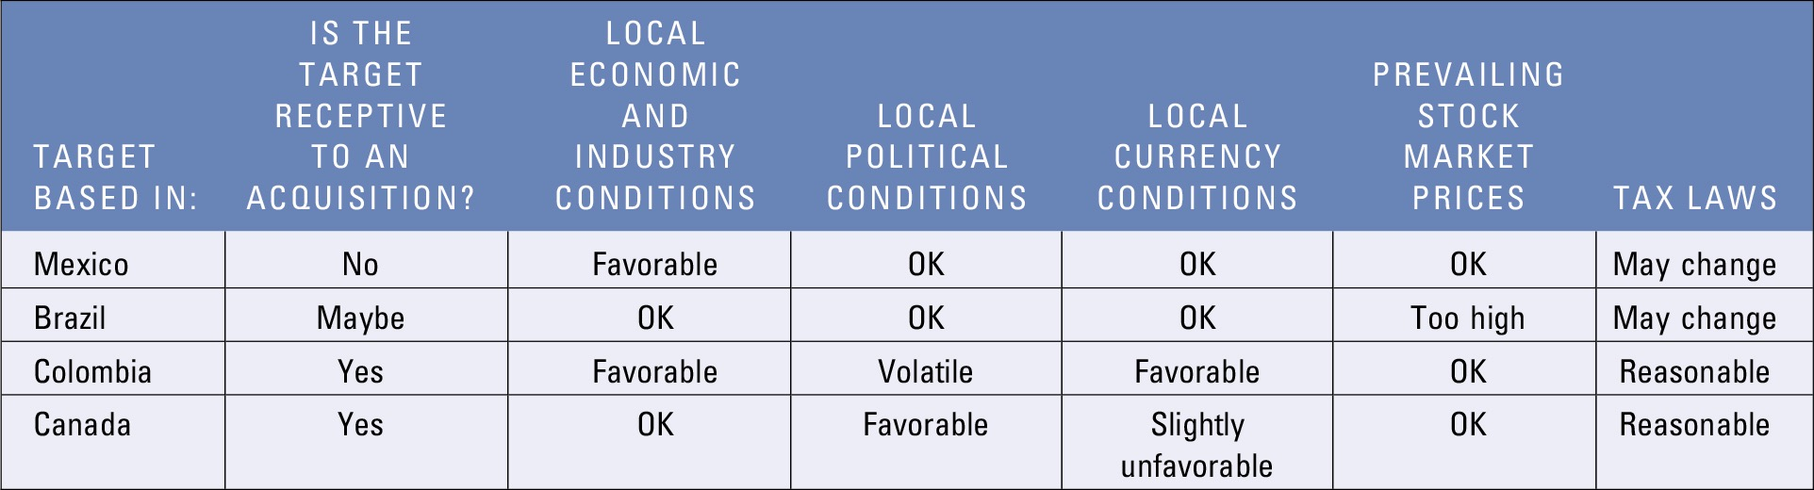
Exhibit 15.1 Example of Process Used to Screen Foreign Targets

Slide 16
Example of the Valuation Process (2 of 5)
Estimating the Target’s Value (Exhibit 15.2)
Estimated Revenue of Target — Forecasted revenues are C$100 million next year, C$93.3 million in the following year, and C$121 million in the year after that.
Estimated Expenses of Target — Cost of goods sold expected to fall to 40% of revenue because of improvements in efficiency.
Estimated Earnings of Target — Earnings before taxes and earnings after taxes are estimated.

Slide 17
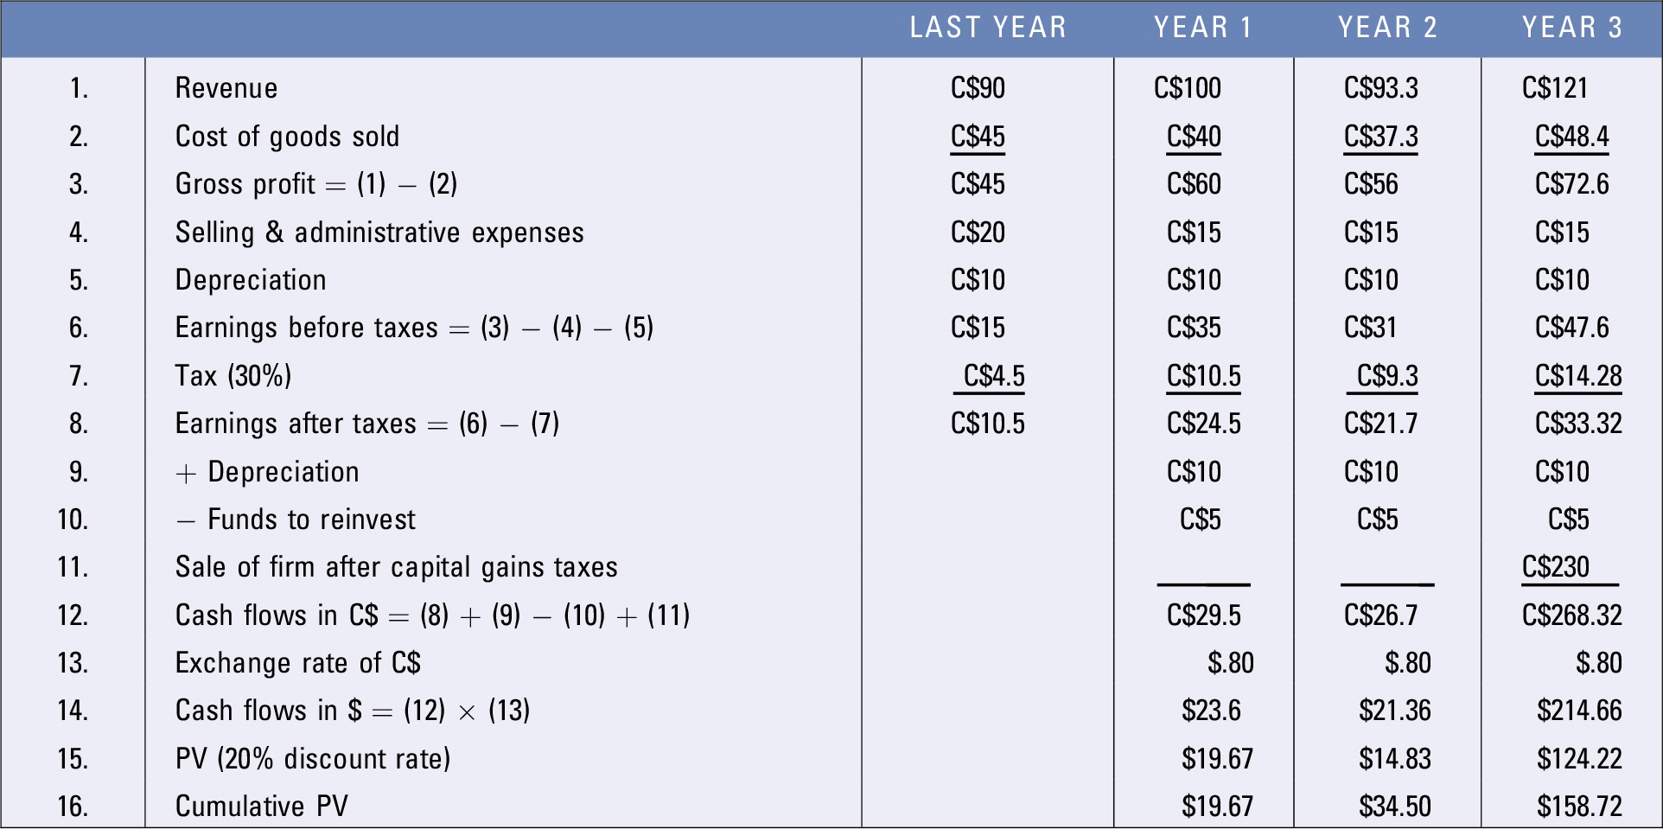
Exhibit 15.2 Valuation of Canadian Target Based on the Assumptions Provided (in Millions of Dollars)

Slide 18
Example of the Valuation Process (3 of 5)
Estimating the Target’s Value (cont.)
Cash Flows to Parent — Because Lincoln’s parent wishes to assess the target from its own perspective, it focuses on the dollar cash flows that it expects to receive.
Valuing the Present Value of Estimated Cash Flows — Assuming a required rate of return of 20%, the present value of the target is estimated to be $158.72 million after 3 years.

Slide 19
Example of the Valuation Process (4 of 5)
Estimating the Target’s Value (cont.)
Sources of Uncertainty
  Growth rate of revenue is subject to uncertainty.
  Cost of goods sold could exceed assumed level.
  Selling and administrative expenses could exceed assumptions.
  Corporate tax rate could increase.
  Exchange rate may be weaker than expected.
  Estimated selling price of target in future may be incorrect.

Slide 20
Example of the Valuation Process (5 of 5)
Changes in Valuation Over Time
Impact of stock market conditions — A change in stock market conditions affects the price per share of each stock in that market.
Impact of credit availability — Greatly impacts the ability of MNCs to make acquisitions.
Impact of exchange rates — If the foreign currency appreciates by the time the acquirer makes payment, the acquisition will be more costly.
Impact of market anticipation regarding the target — The stock price of the target may increase if investors anticipate that the target will be acquired because they are aware that stock prices of targets rise abruptly after a bid by the acquiring firm.

Slide 21
Disparity in Foreign Target Valuations
Expected cash flows of the foreign target — Each MNC may have a different plan as to how the target will fit within its structure and how the target will conduct future operations.
Exchange rate effects on remitted earnings — Valuation can vary among MNCs simply because of differences in the exchange rate effects.
Required return of the acquirer — The valuation of the target could also vary among MNCs because of differences in their required rate of return.

Slide 22
Other Corporate Control Decisions (1 of 4)
International partial acquisitions — A partial international acquisition requires less funds because only a portion of the foreign target’s shares are purchased.
Valuation Process — When an MNC considers a partial acquisition it must take the perspective of a passive investor rather than as a decision maker.

Slide 23
Other Corporate Control Decisions (2 of 4)
International acquisitions of privatized businesses
Valuation Process (difficult for following reasons):
  Future cash flows are uncertain due to introduction of competition.
  Data regarding value and benchmarks are limited.
  Economic conditions are uncertain in transitional economies.
  Political conditions are volatile.
  Potential conflict between government control and acquirers may exist.

Slide 24
Other Corporate Control Decisions (3 of 4)
International Divestitures — Common external forces that could reduce the present value of a foreign subsidiary’s future cash flows.
  A weakening economy in the host country could reduce expected cash flows to be generated by the subsidiary,
  a reduction in the local currency of the host country could reduce the exchange rate at which the cash flows generated by the subsidiary would be converted to dollars,
  higher taxes imposed by the host government would reduce the expected cash flows of the subsidiary

Slide 25
Other Corporate Control Decisions (4 of 4)
International Divestitures (cont.)
  An increase in the MNC parent’s cost of capital would increase the discount rate at which expected future cash flows are discounted when determining the present value of the subsidiary.
  Valuation process
    The valuation of a proposed international divestiture requires comparing the present value of the cash flows if the project is continued to the proceeds that would be received (after taxes) if the project is divested. (Exhibit 15.3)

Slide 26
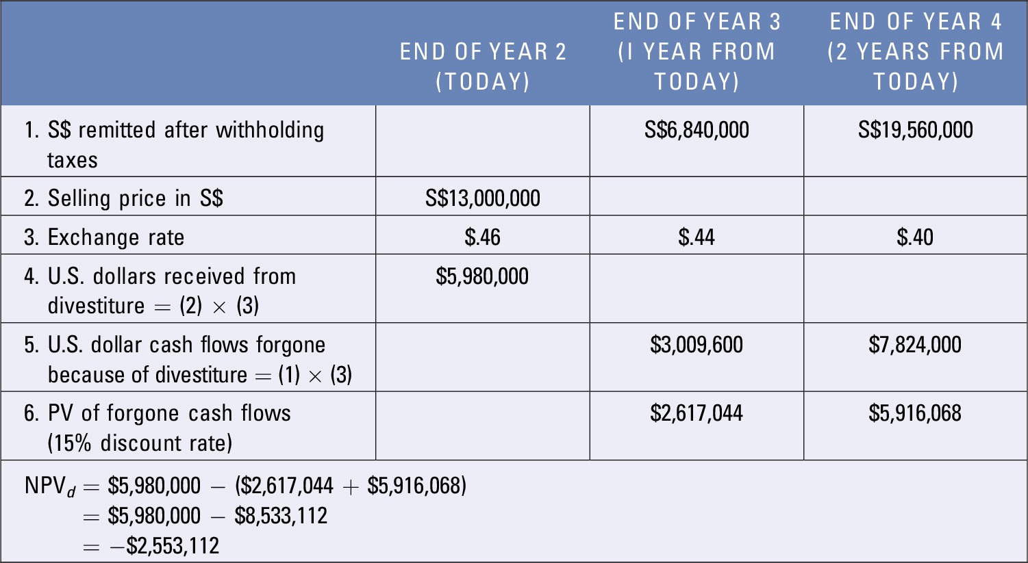
Exhibit 15.3 Divestiture Analysis: Spartan, Inc.

Slide 27
Control Decisions as Real Options
Real Options are implicit options on real assets such as buildings, machinery, and other assets.
Call option on real assets represents a proposed project that contains an option of pursuing an additional venture.
Put option on real assets represents a proposed project that contains an option of divesting part or all of the project.

